Slide 1
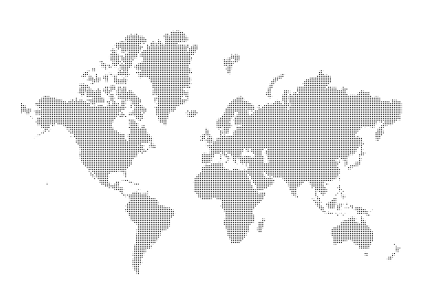
The Changing Earth

Slide 2
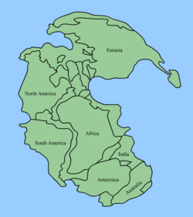
Continental Drift
Continental Drift: idea that all continents had once been joined in a single super continent called PANGAEA
Proposed by German scientist, Alfred Wegener in 1912
Pangaea existed a few hundred million years ago
Over time, Pangaea broke apart and continents SLOWLY moved toward current locations

Slide 3
Evidence
Landforms:
Mountain ranges in South America line up with mountain ranges in Africa
Climate:
Geologic record shows that South Africa was once covered by glaciers, so the continents must have moved
Fossils:
Fossils of reptiles have been found in locations separated by oceans
These reptiles could not swim great distances
Therefore, they likely lived on 1 landmass that split apart
Nobody believed theory because Wegner couldn’t explain why it happened

Slide 4
Convection
Notes on board (lava lamp and interior of the Earth)

Slide 5
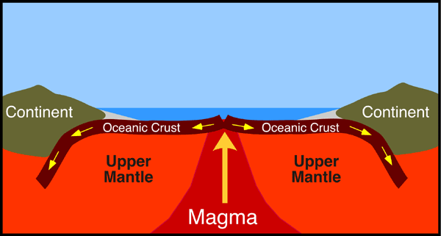
Seafloor Spreading
Scientists still did not believe Wegener’s theory; they wondered how could continents plow through hard, solid ocean floor
In 1950s and 1960s, new technology (SONAR) became available to explore the ocean floor
Scientists discovered mid-ocean ridges: underwater mountain ranges with deep cracks which allow magma to pass through
So, the ocean floor can actually move, and when it does it takes the continents with it
Rocks next to mid-ocean ridges are younger and older rocks move farther away from the ridge http://www.wwnorton.com/college/geo/egeo/flash/2_5.swf

Slide 6
Seafloor Spreading
Proposed by: Harry Hess, an American Geologist (1960’s)
Definition: The process by which molten material adds new oceanic crust to the ocean floor; ocean floor is moving apart.
Evidence:
Molten Material – The crew of Alvin, a submarine, found rocks shaped like pillows or toothpaste from a tube. The rocks form when molten material hardens quickly after erupting under water.

Slide 7
Seafloor Spreading
Magnetic Stripes: Rocks that make up the ocean floor lies in a pattern of magnetic stripes; magnetic field reversed many times.
Drilling Samples: A drilling ship, The Glomar Challenger, sent drilling pipes 6km deep to the ocean floor to extract samples. Scientists found the farther away from the ridge the samples were taken, the older the rocks were. The youngest rocks were always in the center of the ridges.

Slide 8
Seafloor Spreading
Mid-Ocean Ridge – the longest chain of mountains in the world---these are divergent plate boundaries

Slide 9
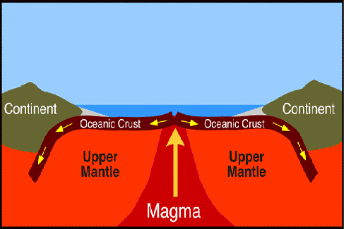
Seafloor Spreading

Slide 10
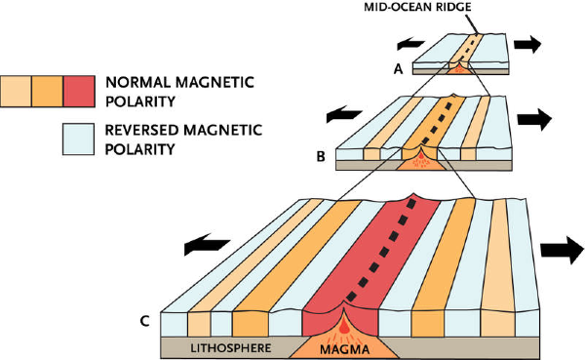
Seafloor Spreading

Slide 11
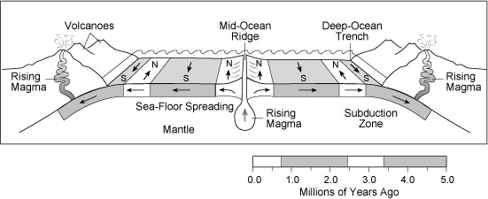
Seafloor Spreading

Slide 12
Plate Tectonics
Developed in 1960s
Links together Continental Drift and Seafloor Spreading theories
Explains how Earth has changed over time
Also, explains the formation, movements, collision, and destruction of Earth’s crust

Slide 13
Plate Tectonics
Plates: moving, irregular shaped pieces of the lithosphere (crust and uppermost mantle)
Usually contain both oceanic and continental crust
Move because of convection currents!

Slide 14
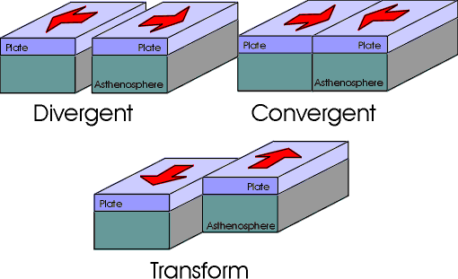
Plate Boundaries
3 Types:
Divergent: plates move apart
form mid-ocean ridges
Convergent: plates move together
form trenches, volcanoes, and mountain ranges
Continent collides with continent: mountain ranges
Oceanic collides with oceanic: 1 subducts/sinks, may form volcanoes
Continent collides with oceanic: oceanic plate subducts/sinks, melted material may rise in volcano
Transform Fault: plates slide past each other
form earthquakes

